Slide 1
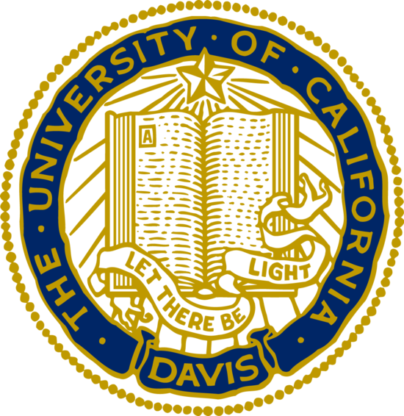

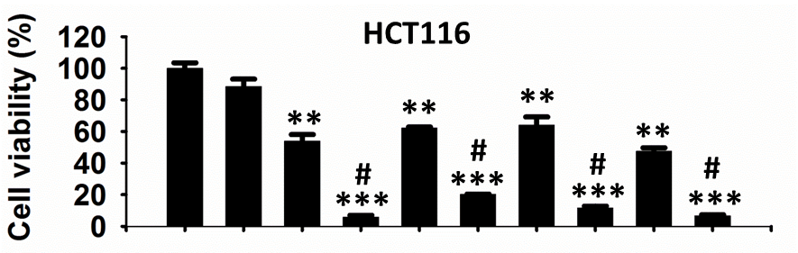
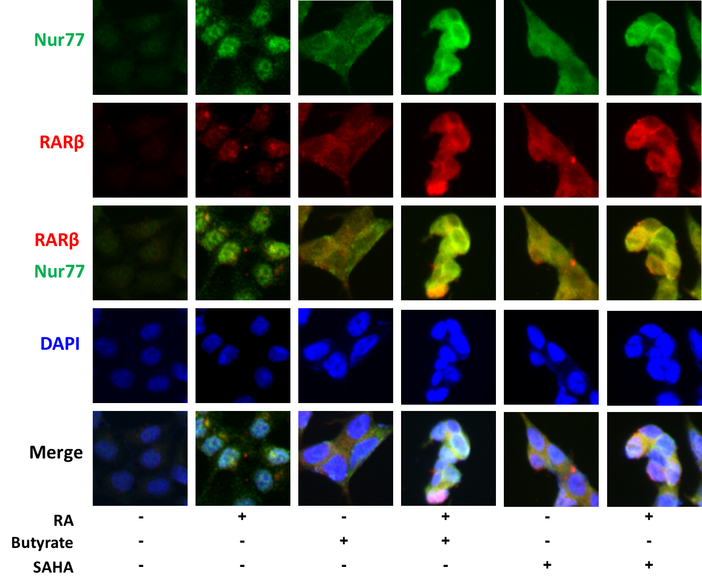
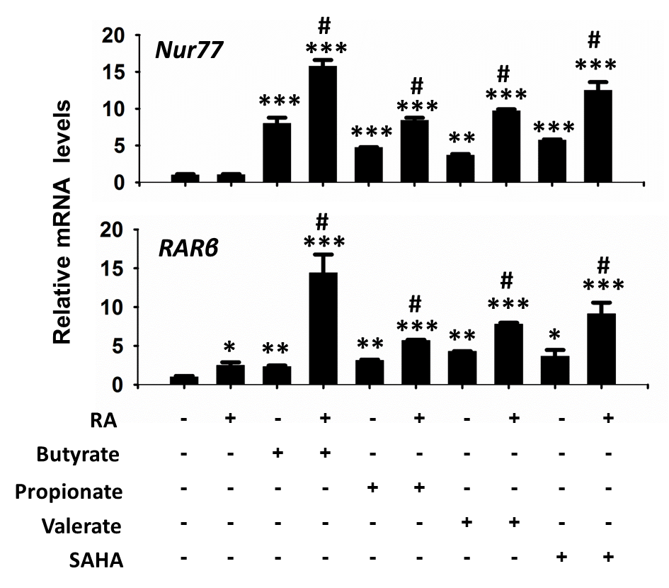
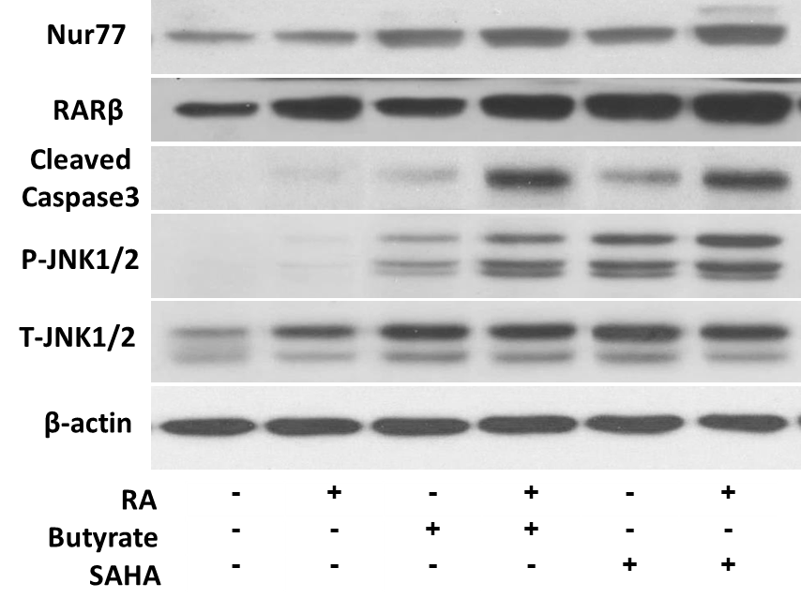
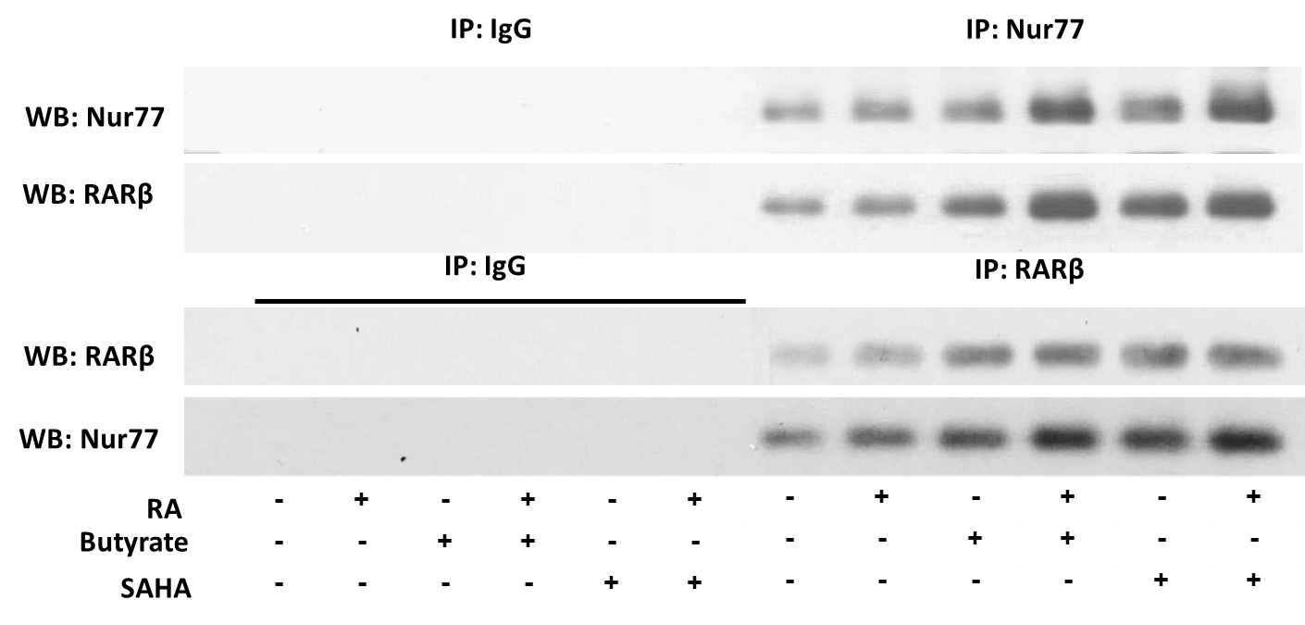
RA and HDACi synergistically induce colon cancer cell apoptosis via RARβ and Nur77 upregulation and nuclear export
Thinh Chau, Ying Hu, Yu-Jui Yvonne Wan
Department of Medical Pathology and Laboratory Medicine, University of California, Davis, Sacramento, CA
Abstract
Results
Propionate and valerate were much less robust apoptotic inducers and upregulators of RARβ-Nur77 at the mRNA level compared to butyrate and SAHA. Thus, subsequent experiments were conducted using butyrate or SAHA to represent endogenous and exogenous HDACi, respectively . RARβ-Nur77 were dramatically enriched in the cytosol of RA/HDACi-treated cells on immunofluorescence microscopy. Consistently, Western blot showed that RA/HDACi elevated RARβ, Nur77, cleaved Caspase3, and phosphorylated JNK1/2, which is associated with Nur77 nuclear export. Lastly, co-immunoprecipitation assay confirmed that RARβ-Nur77 protein-protein interaction was notably increased in RA/HDACi-treated cells.
Introduction: All-trans retinoic acid (RA) is a biologically active metabolite of vitamin A and a natural agonist for tumor suppressor retinoic acid receptor β (RARβ). Butyrate is a short chain fatty acid and an endogenous histone deacetylase inhibitor (HDACi), produced by dietary fiber fermentation by colonic Gram-positive bacteria. HDACi blocks histone deacetylase activity which functions to alter local chromatin structure and consequently, gene transcription activity. We tested the hypothesis that RA and HDACi, such as butyrate, act through RARβ and its binding partner, Nur77, to promote colon cancer cell apoptosis. Nur77 is an orphan nuclear receptor capable of exerting a pro-survival effect when in the nucleus versus a pro-apoptotic effect when in the cytosol.
Methods: Human colon cancer HCT116 cells were cultured in McCoy’s 5a media with 10% FBS until they reached 80% confluency. Cells were then treated with single or combination treatment in serum-free media. For cell viability assay, treated cells were incubated with MTT in serum-media followed by cell lysis and colorimetric analysis using a microplate reader. For RT-qPCR assay, total RNA was isolated from treated cells using TRIzol homogenization followed by isopropanol precipitation. The isolated total RNA was reverse transcribed to generate cDNA for SYBR Green RT-qPCR using primers specific for Nur77 and RARβ. For immunofluorescence staining, treated cells were fixed in 4% formaldehyde in PBS, stained with primary antibodies against Nur77 and RARβ and corresponding Alexa Fluor secondary antibodies, mounted with ProLong Gold reagent, and visualized with confocal microscopy. For Western blot and co-immunoprecipitation assays, whole cell lysates were obtained from treated cells using M-PER solution.
Findings: Our data showed that RA/HDACi combination treatment markedly induced apoptosis and RARβ-Nur77 expression compared to single compound treatment in HCT116 colon cancer cells. We also assayed two other short chain fatty acids, propionate and valerate, for their ability to induce colon cancer cell apoptosis as well as upregulate RARβ-Nur77. Suberanilohydroxamic acid (SAHA) also known as Vorinostat, an exogenous HDACi and FDA approved antineoplastic agent, was also assayed.
RA/HDACi promote apoptosis and induce RARβ, and Nur77 mRNA levels
RA/HDACi induce RARβ-Nur77 co-upregulation and nuclear export
Conclusion
Conclusion: In this report, we showed that RA combined with HDACi, endogenous butyrate or exogenous SAHA, potently induce apoptosis in colon cancer cells. RA/HDACi exert a synergistic pro-apoptotic effect in HCT116 colon cancer cells by upregulating RARβ-Nur77 expression, nuclear export, and protein-protein interaction. RA/HDACi can potentially augment existing approaches to the prevention and/or treatment of colon cancer such as the use of probiotics or prebiotics to enrich for butyrate-producing colonic bacteria. Additional work is required to elucidate the potential mechanisms mediating RA/HDACi actions including altered acetylation patterns of histones at the RARβ, Nur77 promoter regions and of RARβ, Nur77 proteins themselves.
Figure 1. HCT116 cells were treated with indicated chemicals for 48 hours. Cell viability was measured by MTT assay. Data were expressed as mean± SD (n=3). The mRNA levels of Nur77 and RARβ in HCT116 treated with indicated chemicals were measured by qRT-PCR. *p < 0.05, **p < 0.01, *p < 0.005, versus DMSO, # p < 0.05 versus each individual treatment.
Figure 3. Expression and localization of Nur77 and RARβ as visualized by immunofluorescence microscopy in RA, butyrate, SAHA and the combination of RA and butyrate or SAHA treated HCT116 cells. Cells were immunostained with antibodies specific to Nur77 and/or RARβ followed by appropriate Alexa Fluor secondary antibodies and viewed using confocal microscopy.
RA/HDACi upregulate RARβ, Nur77, cleaved Caspase3, P-JNK1/2, and T-JNK1/2
RA/HDACi increase RARβ-Nur77 protein-protein interaction
Acknowledgements
This study is supported by the Stowell Endowed Medical Student Pathology Research Fellowship and UC Davis Health System Department of Pathology and Laboratory Medicine.
Figure 2. Western blot was performed to determine protein levels of Nur77, RARβ, cleaved Caspase3, phospho (P)-JNK1/2 and total (T)-JNK1/2 in treated cells as indicated.
Figure 4. Whole cell lysates extracted from treated HCT116 as indicated were immunoprecipitated by anti-Nur77 and RARβ antibodies or IgG followed by Western blot using anti-RARβ and or anti-Nur77 antibodies.

